Slide 1

DEMO VIDEO INCLUDED!
SKILLIT
Oh, The Places You’ll Go
Notes:
We were inspired by RBC to tackle the challenge of helping youth develop their skills and careers

Slide 2


BACKGROUND
Problem Statement:
RBC Future Launch recognizes that youth face challenges developing their careers within three key pillars:
Finding work experience
Growing their networks
Gaining new skills

Slide 3
OUR SOLUTION
Our goal for youth in high school who are starting to develop their careers takes a three-keys approach
EXPLORE
BUILD
EXPERIENCE
SKILLIT Career Browser
Youth can find internship opportunities to build valuable experience.
SKILLIT Skills Browser
Youth can test-drive different skills that could spark unique interests
SKILLIT Event Browser
Youth can find and attend valuable workshops and build their network

Slide 4

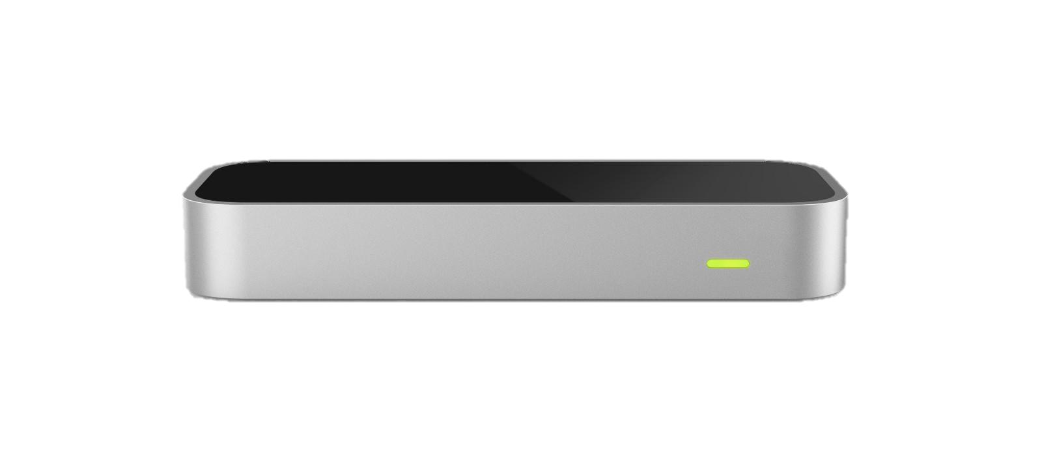

THE USER JOURNEY
EXPLORE
BUILD
EXPERIENCE
Sarah is in grade 11 and really doesn’t know what industry or careers she may be interested in.
By attending a workshop, she was able to meet mentors in the industry, and build a new skill.
Sarah takes up a construction technology course at her high school, and attends a woodworking competition in her region.
She browses through events and workshops in her area through SKILLIT Events
How can she explore new skills?
How might this lead to finding relevant work experience?
Her guidance counsellor recommends trying SKILLET to explore new skills.
How can she build a network of people who may share similar interests?
Sarah browses on SKILLIT Career, applies for a co-op position, and gets an offer!
She signs out a LEAPmotion/VR to test drive some virtual experiences on SKILLIT Skills
She tries simulated welding, carpentry, programming, and realizes carpentry seems of interest.

Slide 5



SKILLIT Skills Browser
SKILLIT Skills
SKILLIT Skills
SKILLIT Skills
SKILLIT Careers
Completed Modules
Recommended
SKILLIT Events
My Profile
Settings
In Progress
Carpentry
Sawing
Launch
Sawing
Launch
Welding
Launch
Welding
Launch
Programming
C#
Launch
Java
Launch
My Skills
Browse Skills
My Skills
Browse Skills
My Skills
Browse Skills

Slide 6
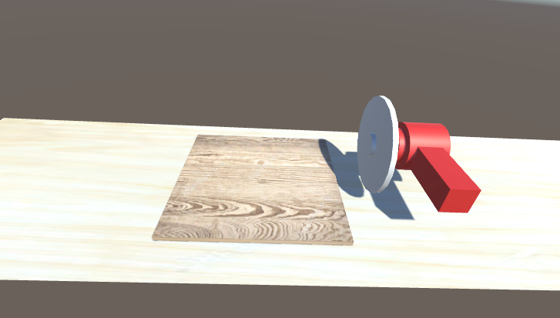
Sawing Skill Demo

Slide 7
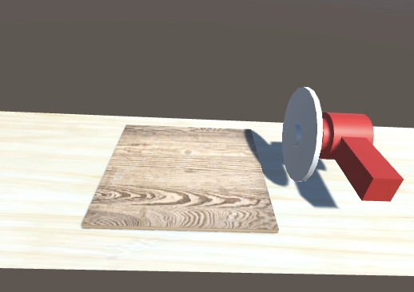
Sawing Skill Demo

